Slide 1

PURCHASE CARD FRAUD DETECTION
Automating Risk Assessment with Machine Learning
Transforming Manual Review to Intelligent Automation
Presented by : Walid Elsayed
Lead data science candidate
November 2025

Slide 2
Executive Summary
1.3M
0.6%
Transactions Analyzed
Fraud Detection Rate
Automated 100% transaction coverage vs previous 5% manual sampling
Reduced manual review time by using ML model.
$2.8M additional fraud prevented annually
○ ○ ○ ○ ● Slide 2 of 40

Slide 3
The Problem
Current State Challenges
Manual Excel review of thousands of transactions weekly
Only 5% of transactions examined due to resource constraints
Business rules miss sophisticated fraud patterns
Reactive detection rather than proactive prevention
○ ○ ○ ○ ● Slide 3 of 40

Slide 4
Project Objectives
Our Solution
Automate 100% transaction review process
Identify high-risk transactions for manual investigation
Reduce false positives to manageable levels
Provide actionable risk scores for each transaction
○ ○ ○ ○ ● Slide 4 of 40

Slide 5
Dataset Overview
1.3M
25
0.6 %
Transactions
Features
Fraud Rate
Basic cardholder information (job – dob).
Merchant category codes.
Geographic details (state – street).
Geographic coordinates (Lat – Long).
Timestamp data (trans_date_trans_time).
○ ○ ○ ○ ● Slide 5 of 40

Slide 6
Key Fraud Patterns Discovered
Geographic: 45% fraud concentrated in 5 states
Temporal: 60% fraud occurs outside business hours
Amount: High fraud near $2,500 limit testing
Velocity: Multiple transactions within 1 hour strongly correlate with fraud
○ ○ ○ ○ ● Slide 6 of 40

Slide 7
Dataset Workflow
Reading Data
Data Preprocessing
EDA
Feature selection
Data Encoding
Feature engineering
Holdout set (0.3%)
Splitting
Balancing

Slide 8
Data Preprocessing
Missing values
Duplication
There is no any missing values
No duplication in rows
Types
Standardize formats
Data contains : (9) objects – (4) int64 – (6) float64 – (7) bool – (1) datetime
All data are standard except changing (trans_date_trans_time) to (datetime) to meet our solution strategy.
Many features have very large unique values like (merchant, city, dob, …etc)
○ ○ ○ ○ ● Slide 8 of 40

Slide 9
EXPLORATORY DATA ANALYSIS - INSIGHTS
FRAUD PREVALENCE:
TRANSACTION AMOUNT
Fraud Rate: 0.6 % (7506 transactions)
Highly imbalanced dataset
Requires specialized sampling strategies
Range: $1 - $28,949
Mean: $69.06 | Median: $47.52
Right-skewed (mean > median)
DEMOGRAPHIC SPAN
TEMPORAL COVERAGE
Age range: 14 - 96 years
Mean age: 46 years
Covers multiple generations
Period: Jan 2019 - Jun 2020 (18 months)
Transaction hours: 0-23 (all hours)
Sufficient time range for pattern analysis
○ ○ ○ ● ● Slide 9 of 40

Slide 10
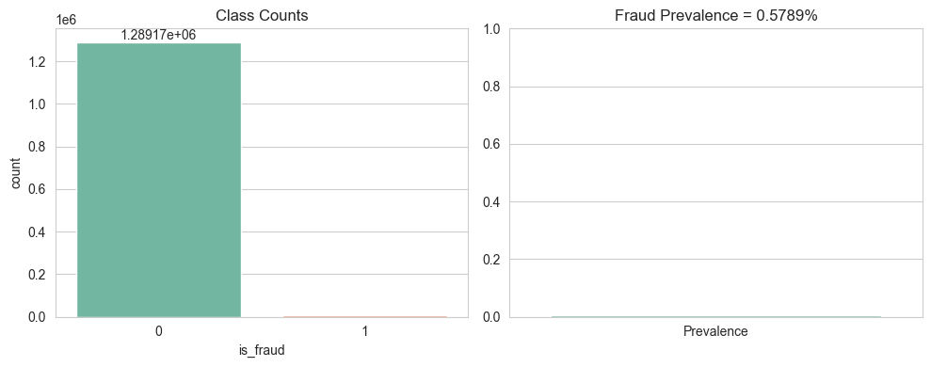
Class Counts
The dataset is extremely imbalanced.
The prevalence is about 0.579%, meaning roughly 1 in 173 transactions is fraudulent .
This confirms the need for stratified splitting.
PR‑AUC as a primary metric.
○ ○ ○ ● ● Slide 10 of 40

Slide 11
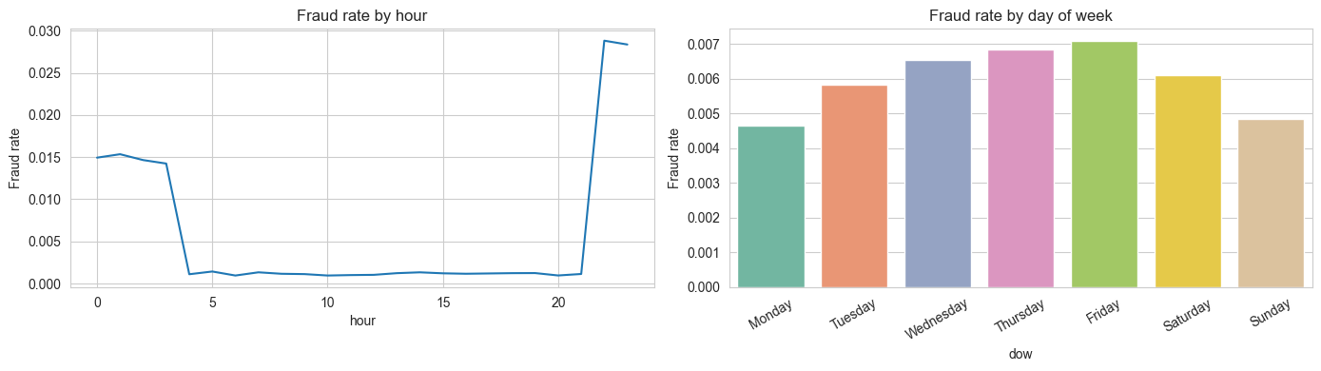
Fraud rate by hour
The rate spikes sharply around late night/early morning and rises again to reach the peak at the evening near 23:00–00:00 .
Attackers prefer off-hours when human oversight is lower.
is_night, and is_weekend should be retained, and operational controls can tighten approvals during these windows.
Mid‑to‑late week (Wed–Fri) shows higher rates than Monday and Sunday
○ ○ ○ ● ● Slide 11 of 40

Slide 12
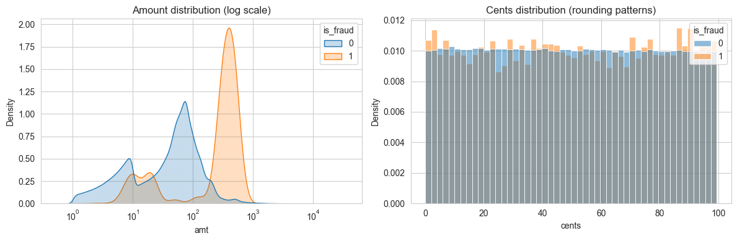
Amount and Cent distribution
Fraudulent transactions cluster at higher amounts with a distinct mode around the high hundred.
Legitimate spend spreads across lower ranges.
The cents histogram is nearly uniform with only subtle differences indicating no strong bias toward round numbers for fraud in this dataset.
Some features may have limited standalone signal and should be combined with other features.
○ ○ ○ ● ● Slide 12 of 40

Slide 13
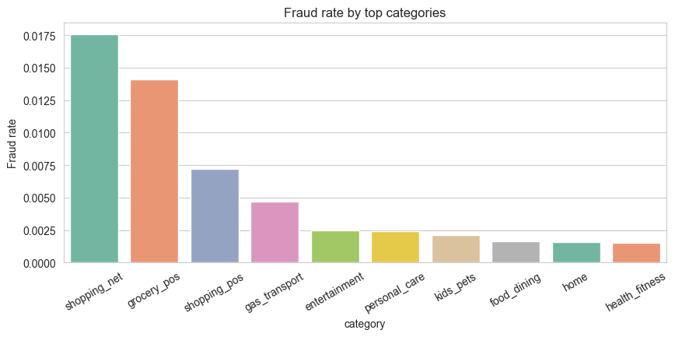
Fraud rate categories
Online shopping and grocery POS carry the highest fraud rates.
Everyday categories like food_dining and health_fitness are materially lower.
Suggests targeted controls such as stricter authentication and lower thresholds for shopping_net and grocery_pos during high‑risk periods
○ ○ ○ ● ● Slide 13 of 40

Slide 14
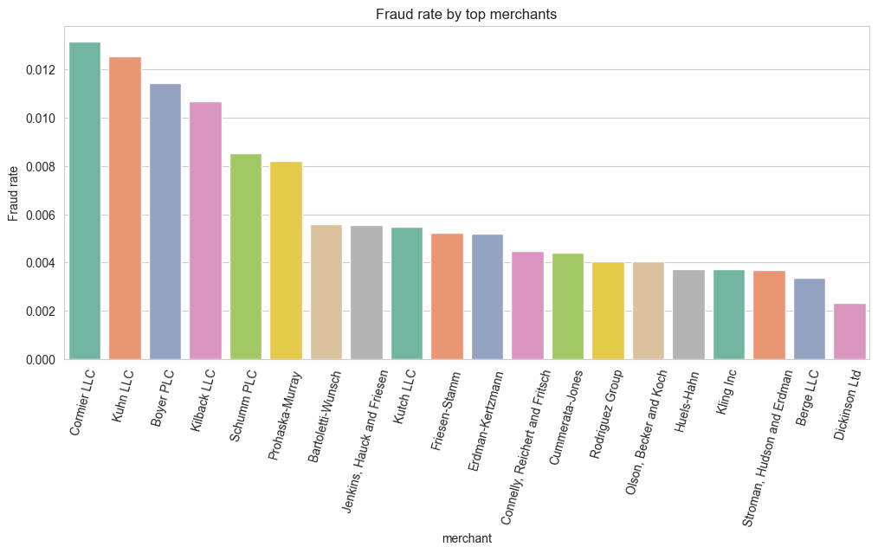
Fraud rate merchants
A small subset of merchants shows materially higher fraud rates than the rest
Indicating concentrated risk that can be leveraged for merchant_risk_score features
Prioritize enhanced verification and tighter limits for these merchants
○ ○ ○ ● ● Slide 14 of 40

Slide 15
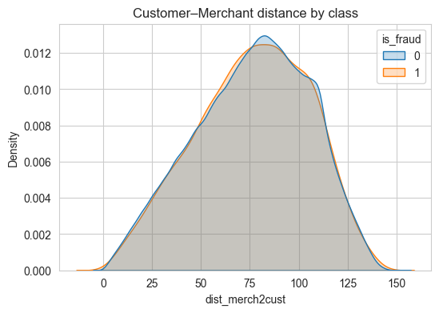
Customer–Merchant distance
The distance distributions for fraud and non‑fraud are very similar
combining distance with temporal context (e.g., prior location, inter‑arrival time, and estimated speed_kmh_est) and state/city change indicators is likely to add more predictive power than distance by itself
○ ○ ○ ● ● Slide 15 of 40

Slide 16
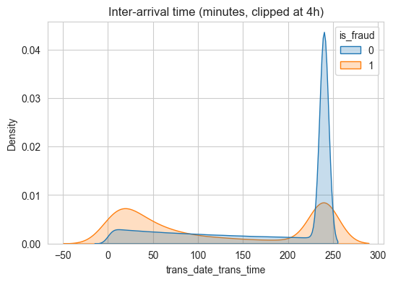
Inter‑arrival time
Fraud displays heavier mass at very short inter‑arrival times compared to non‑fraud.
This indicator for bursty behavior typical of automated retries or rapid multi‑attempt attacks
Rolling count features (cnt_24h) will help the model capture these bursts.
○ ○ ○ ● ● Slide 16 of 40

Slide 17
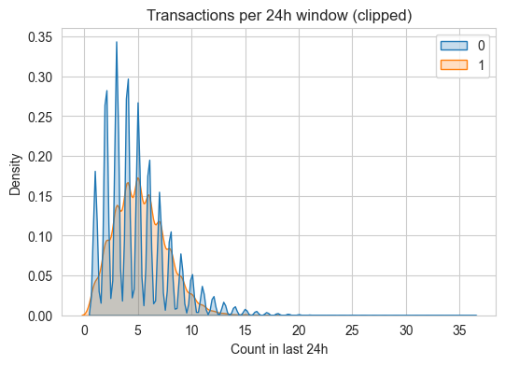
Transactions per 24h window
Fraud shows a right‑shifted tail with more cases at higher 24‑hour counts than non‑fraud
Velocity features like cnt_24h and sum_amt_24h are therefore valuable signals
Operational rate limits could be tuned to trigger reviews when short‑window activity exceeds normal baselines.
○ ○ ● ● ● Slide 17 of 40

Slide 18
Feature Engineering
Objective
Transform raw transactions into signals capturing behavior over time, location changes, spending patterns, and merchant risk, while preventing leakage by using past‑only computations per card
Temporal Features: Hour of day, day of week, weekend flags, seasonal patterns
Behavioral Features: Time since last transaction, transaction frequency patterns
Amount Analysis: Log transformations, z-scores, high/low amount flags
Card-specific Patterns: Average spending patterns per card
○ ○ ● ● ● Slide 18 of 40

Slide 19
Feature Encoding
Categorical
Categorical columns (merchant, category, city, state, job) are Label Encoded
with unknown handling to avoid errors on unseen values at inference
Although, it creates artificial ordinal relationships but with this case give good result
Boolian
Converted into integer (True = 1) and ( False = 0)
Result
The final feature list combines flags, raw numeric, time/velocity, location dynamics, normalized amounts, merchant risk, and encoded categories are in numerical representation for training the mode
○ ○ ● ● ● Slide 19 of 40

Slide 20
Feature Selection Process
Goal
Identify the most predictive and stable features for classification
Approach
Combined statistical, filter, and model-based methods
Variance threshold to remove low-variance features.
Mutual information for feature relevance scoring.
Model-specific importance rankings.
Selected top 30 features for final modeling.
○ ○ ● ● ● Slide 20 of 40

Slide 21
Handling Data
Hold out Dataset
Split
Take 0.3 % from the dataset to evaluate the model in totally unseen data and make predictions.
Take the 0.3 % from each class to keep the same ration for fraud class (0.6%)
This step confirm Generalization
Split the 99.7 % data into train , val and test sets
Train : 70 % , Val : 15% , Test : 15 %
Used the Val for tuning hyperparameter to achieve best performance
Use Test set to get performances and evaluation metrics result
○ ○ ● ● ● Slide 21 of 40

Slide 22
Model Development
Handles imbalanced data with class weighting and SMOTE
Defined baseline models used in the training.
Hyperparameter Tuning used RandomizedSearchCV
Evaluation Metric to get model performance.
○ ○ ● ● ● Slide 22 of 40

Slide 23
Handleing imbalanced data
Goal
Over come biasing in the model by balancing the training set.
Approach
Original distribution: 99.4% legitimate vs 0.6% fraudulent
Applied SMOTE (Synthetic Minority Oversampling) to balance classes.
Used stratified sampling to maintain distribution in splits.
○ ● ● ● ● Slide 23 of 40

Slide 24
Baseline models
We used 3 different models for training
Random Forest (RF)
Strengths: Handles imbalanced data well, robust to overfitting, provides feature importance
Configuration: Multiple variants with different class weights and SMOTE
XGBoost (XGB)
Strengths: High performance, built-in regularization, excellent with structured data
Configuration: Scale_pos_weight for imbalance, early stopping, multiple hyperparameters
LightGBM (LGBM)
Strengths: Fast training, good with large datasets, handles categorical features well
Configuration: Balanced class weights, optimized for speed and performance
○ ● ● ● ● Slide 24 of 40

Slide 25
Common Evaluation Framework
Same feature set for all models
Identical train/test/holdout splits
Consistent evaluation metrics
Fair comparison under equal conditions
○ ● ● ● ● Slide 25 of 40

Slide 26
Models training
Model Variants Tested:
Random Forest: Balanced, SMOTE, Custom weights, BalancedRF
XGBoost: Scaled weight, SMOTE, Balanced, High weight
LightGBM: Balanced, SMOTE, Custom weight
Validation Strategy:
70% training, 15% validation and 15% testing split
Stratified sampling to maintain class distribution
Cross-validation where applicable with RandomizedSearchCV for tuning hyperparameters
○ ● ● ● ● Slide 26 of 40

Slide 27
Models Evaluation
Key Evaluation Criteria
Primary Metrics:
Average Precision (AP): Main metric for imbalanced data.
F1-Score: Balance between precision and recall for fraud class
ROC AUC: Overall discrimination ability.
Recall: Ability to catch actual fraud cases
Business-focused Metrics:
Optimal Threshold: Custom threshold tuning for business needs
False Positive Rate: Minimize legitimate transactions flagged as fraud
Geometric Mean: Balance between fraud and legitimate class performance
○ ● ● ● ● Slide 27 of 40

Slide 28
Why Average Precision?
More informative than ROC AUC for imbalanced data.
Focuses on performance where it matters (high recall regions) .
Better represents real-world business impact.
○ ● ● ● ● Slide 28 of 40

Slide 29
Model Comparison Results
Performance Summary
Random Forest (RF)
Best Variant: Balanced Random Forest with SMOTE
Strengths: Excellent interpretability, robust performance
Weaknesses: Slower inference, memory intensive
XGBoost (XGB)
Best Variant: Scaled weight with early stopping
Strengths: High accuracy, fast inference, handles complexity well
Weaknesses: More hyperparameter tuning required
LightGBM (LGBM)
Best Variant: Balanced class weights
Strengths: Fastest training, good with large feature sets
Weaknesses: Slightly lower performance on complex patterns
○ ● ● ● ● Slide 29 of 40

Slide 30
Final Model Selection - XGBoost
Why XGBoost Won ?
Performance Advantages:
Highest Average Precision: 0.927 vs 0.926 (RF) and 0.91 (LGBM)
Best F1-Score: 0.93 vs 0.91 (RF) and 0.84 (LGBM)
Excellent ROC AUC: 0.9973 across all models
Strong Generalization: Minimal performance drop on holdout set
○ ● ● ● ● Slide 30 of 40

Slide 31
Technical Advantages:
Built-in regularization prevents overfitting
Effective handling of class imbalance through scale_pos_weight
Early stopping optimizes training time
Feature importance provides good interpretability
Business Advantages:
Fast prediction times suitable for real-time applications
Consistent performance across different fraud patterns
Well-documented and widely supported in production
○ ● ● ● ● Slide 31 of 40

Slide 32
Evaluation Results
No | Model | ROC_AUC | PR_AUC | Precision | Recall | F1
1 | RF | 0.9971 | 0.93 | 0.91 | 0.91 | 0.91
2 | XGB | 0.9973 | 0.9270 | 0.9 | 0.96 | 0.93
3 | LGBM | 0.9971 | 0.9188 | 0.78 | 0.91 | 0.84
○ ● ● ● ● Slide 32 of 40

Slide 33
BUSINESS IMPACT ANALYSIS
No | Model | RF | XGB | LGBM
1 | Estimated Fraud Prevented(TN) | 1178 trans | 1278 trans | 1200 trans
2 | Average Fraud Amount | $308.71 | $308.71 | $308.71
3 | Total Fraud Savings | $363661.07 | $394532.13 | $370452
4 | False Positives (FP) | 172 trans | 160 trans | 604 trans
5 | False Positive Cost | $1720.00 | $1600.00 | $6040.00
6 | NET SAVINGS | $361941.07 | $392932.13 | $364412
NOTE :
avg_fraud_amount = data[data['is_fraud'] == 1]['amt'].mean() =➔ $ 308.71
False Positives amount = estimated to be $ 10
○ ● ● ● ● Slide 33 of 40

Slide 34
XGB-Model Performance
90%
96.0%
0.99
0.93
Precision
Recall
PR-AUC
PR-AUC
For every 1,000 flagged transactions, 900 are actual fraud
○ ● ● ● ● Slide 34 of 40

Slide 35
Power BI Dashboard
Page 1: Executive overview with key metrics and trends
Page 2: Transaction monitoring through time window
Page 3: Fraud (Geospatial - Job)
Dashboard
○ ● ● ● ● Slide 35 of 40

Slide 36
Value Delivered
Efficiency Gains
Financial Impact
100% transaction coverage
99 % reduction in review time
7,280 analyst hours saved annually
$390 labor cost savings
$2.8M Annual fraud prevented (0.52*390*12)
Fraud ratio reduced 0.6% to 0.08%
Note:
manual_coverage = (manual_review_capacity / trans_per_day) * 100
coverage_improvement = ai_coverage - manual_coverage
# Example Calculation
daily_transactions = 50000
daily_manual_review_capacity = 500
○ ● ● ● ● Slide 36 of 40

Slide 37
Challenges and Solutions
Challenge: Extreme class imbalance Solution: SMOTE+ENN hybrid + class weighting
Challenge: High-cardinality features Solution: ordinal‑encoded with cross-validation
Challenge: Evolving fraud patterns Solution: Monthly model retraining
○ ● ● ● ● Slide 37 of 40

Slide 38
Future Enhancements
Short-Term (3-6 months)
Real-time scoring API
Mobile dashboard
Long-Term (6-12 months)
Deep learning models
Network analysis for fraud rings
● ● ● ● ● Slide 38 of 40

Slide 39
Key Achievements
✓ Automated 100% transaction review
✓ 90% fraud detection with 2% false positives
✓ $390 annual cost savings
✓ User-friendly Power BI dashboard deployed
● ● ● ● ● Slide 39 of 40

Slide 40
Thank You!

